Slide 1

Mobile and Social Sensing Systems
TRAIN AROUND
Monitoring Athletes Workout
Using a BLE Star Topology Network
Where every step counts

Slide 2

1. Introduction

Slide 3


Workout monitoring
Smartphones and wearables can help users achieving workout motivation and better health care
*
These technologies can also be used by athletes to track their training progress
*
Sensors information are sometimes useful to trainers to understand how an athlete is perfoming and how to achive better results
*

Slide 4
Lacks of preexisting applications
1
Extra weight
2
Data monitoring
Some workout tracking solutions consists in smartphone applications that force users to carry the device in its hand or in a arm holder
This extra wheight solution could feel unconfortable and lead to a bad user experience
Collected data are often displayed only to the athlete who is training
A real-time data sharing with a trainer's device could be useful to the training session
3
Sensors availability
Smartphones have less available sensors
Wearables are preferred because they can track more accurately movements

Slide 5

Our solution (I)
Lightweight solution
1
Smartwatches are used as information gathering instruments
No need to carry paired phones during the training session
Wearables could provide more sensor data

Slide 6


Our solution (II)
Data sharing
2
Change the one-to-one perspective into a one-to-many perspective
Multiple smartwatches share sensors' data with a central device/node
A trainer can read useful real-time data from the central device and take decisions about them

Slide 7

Our solution (III)
Battery saving & context awareness
3
Avoid internet connection to send data
Stop sensors' data gathering when the athlete stops its activity

Slide 8
2. Challenges and
Design Choices

Slide 9
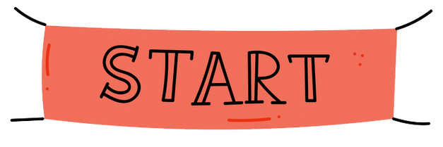




- Build a wearable application
- Exploiting a star topology network
- Real-time monitoring of athletes' activity
Notes:
Let’s start off by considering the walk-though to understand what we done so far to get to the final system architecture.
So here is the starting point, all we knew was that we had to develop a one-to-many local network in which the central node is intended to be the trainer’s device and the wearables as peripheral devices. Another important feature is that we also wanted the workout monitoring sessions to be in real-time.

Slide 10

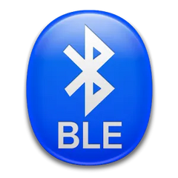
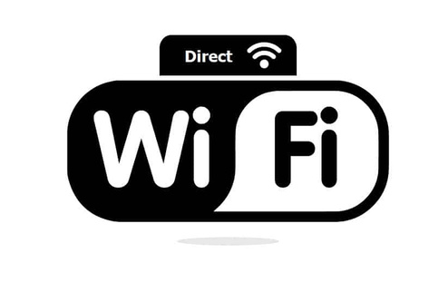

Preliminary work on available literature
01
02
03
Nearby Connection API
Bluetooth Low Energy
Wi-Fi Direct
Notes:
Here in the middle there’s been preliminary work we made on the available literature about the state-of-the-art techniques for connecting devices, that took us a while but was fundamental to understand which would have been the best choice for building our network infrastructure.
We identified 3 main approaches of low-power communication technologies, from the most suitable one to the least, and are listed below: the nearby connection api by Google, the BLE and the Wi-Fi Direct.

Slide 11
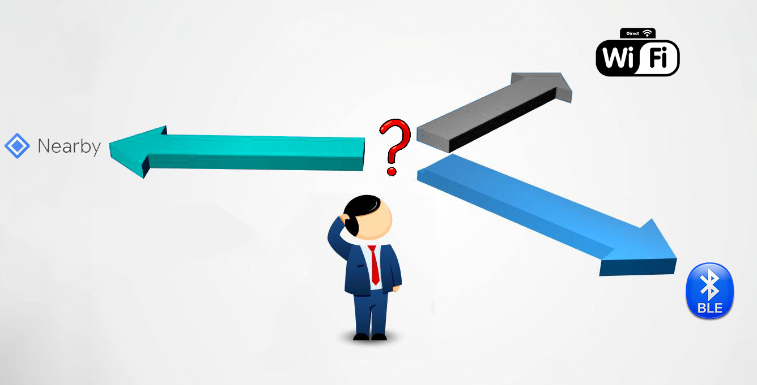
Which one to choose?
Notes:
Once identified the three main possibilities, we had to figure out which one to use, so we started analyzing them one by one, highlighting the biggest benefits and drawbacks applied to our applications’ use cases.

Slide 12

1.
PROS
CONS
- Simple
- Compatibility
- Versatile
- Energy-efficient
Notes:
That has been our first option for a number of reasons: in fact, it’s the most recent technology and it represent the way to go in all those scenarios where you want to connect and communicate between devices without the internet.
- Simple: as it abstracts away the complexity of managing the connection-related aspects, allowing developers to focus on the application logic.
- Versatile: enables upgrading the bandwidth/throughput of a connection by switching between the radios whenever it makes sense

Slide 13
2.
PROS
CONS
- Energy-efficient
- Lower Coverage
- Compatibility
- Usability
- Reliability
- Scalability
Notes:
Energy efficient: is specifically designed for constrained devices that must deal with low energy consumption
Compatibility: Bluetooth is a must-have feature for almost every kind of device, wearable included and compatibility with Bluetooth LE could be cheaply added to devices which support Classic Bluetooth.
Reliability: the freedom to hop across frequency channels, the interference-free and fast advertising ensures a reliable connection even when moving around
Coverage: around 30m in real-life scenarios, that could be an issue for some use cases. Track and field real life scenario would require a little bit extra reachability
Usability: far from being considered a developer-friendly option, both for lack of documentation and demanding low-level code
Scalability: the maximum number of devices that can be paired via BLE to Android is dependent on the specific hardware

Slide 14
3.
PROS
CONS
- Fast DTR
- Power Consumption
- High Coverage
- Connectivity issues
Notes:
Faster: compared to Bluetooth it has a faster data transfer rate. The technology supports a transfer speed of up to 250 Mbps while the current version of Bluetooth has a transfer speed of up to 25 Mbps only. In our case, anyway, this does not represent a true advantage as we don’t need that much high data transfer rate.
High Coverage: theoretically around 200 meters, that would be interesting for our application as we address it to the Track and Field world where distances are in order of hundred of meters
Power Consumption: faster DTR means lower energy efficiency, so we would end up shortening the battery of the wearable pretty fast
Connectivity: we found several user online claiming problems with connecting two or more devices from different manufacturers

Slide 15
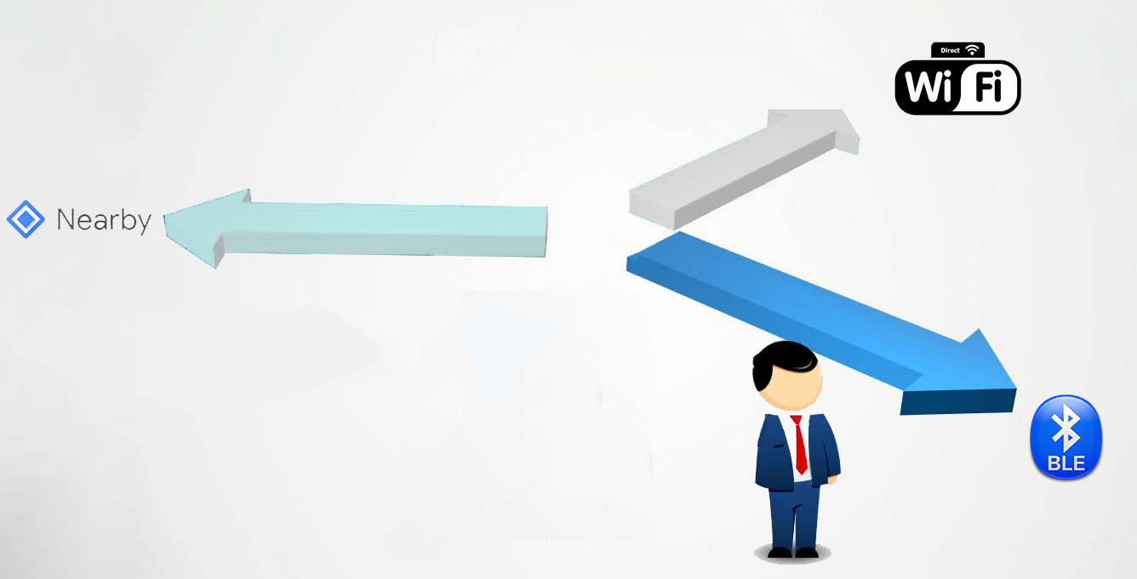


Slide 16
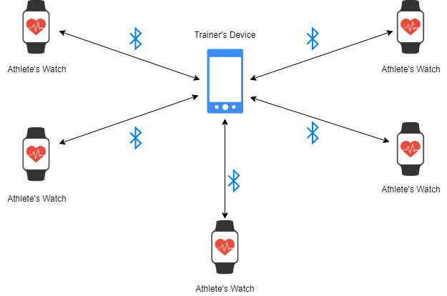
SYSTEM ARCHITECTURE
Notes:
So, we end up building the network onto the BLE GATT library, deploying from scratch the GATT server built in the trainer and the GATT client for athletes.

Slide 17
3. Workout Monitoring

Slide 18
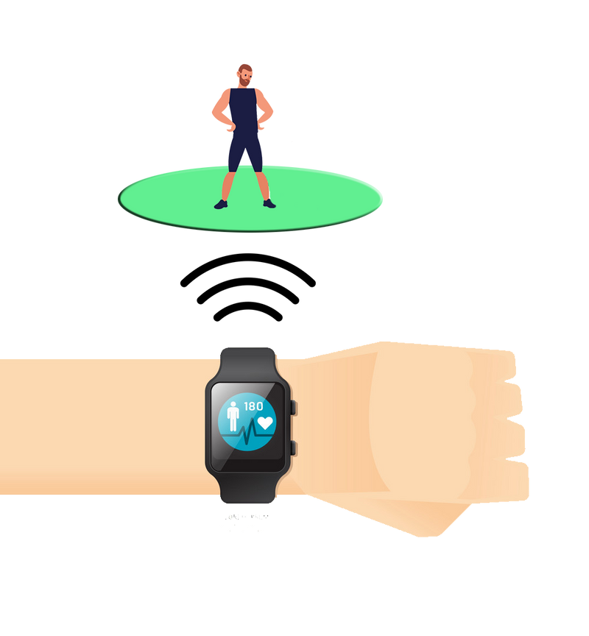
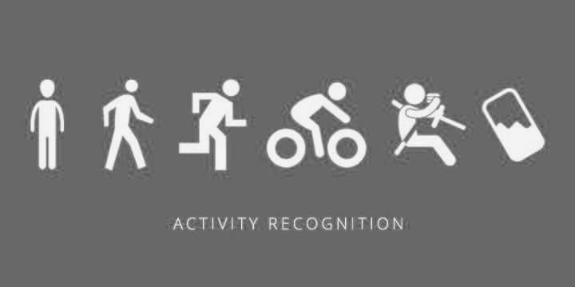
Sensor Choice
Real time data gathering
High-Level Sensors and Statistics
Fast and accurate
Require less data cleaning

Slide 19








Data Collected
Build-in Sensors used:
Step Counter
Heart Rate
Using GPS, we computed:
Speed
Distance
Pace
Notes:
The pace is defined in this formula on the right and it is described as the time needed for an athlete to run or walk across a given threshold in meters, for ur application we decided to use 100 meters, divided by the 100 meters itself. The pace gives us the rithm of the running or walking activity of the athlete that is strictly dependent on the athlete skills

Slide 20




Data Collected
Activity Recognition using Android API
Walking
Still
Running

Slide 21
Context-Aware Optimizations
01
Goal:
02
How is it achieved?
Reduce the battery consumption of our app depending on a specific context
We disabled the GPS (that is energy hungry) when the user is not performing any activity and re-enabled when the user starts a new activity

Slide 22

Context-Aware Optimizations
The activity recognition is strictly dependent on the device used:
Accuracy becomes low when using older devices and activity recognition mechanism becomes slower
Additional Step Counter Check
03
01
02
In this way even if there are some delays or accuracy errors due to the activity recognition, we can collect GPS data anyway
Save the step counter value when the user is detected as STILL by the application
When the new step counter value is greater then the saved value + N steps. GPS is re-enabled.

Slide 23
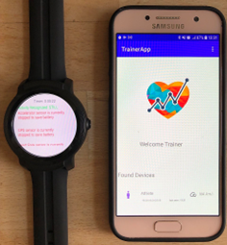
4. Implementation details

Slide 24
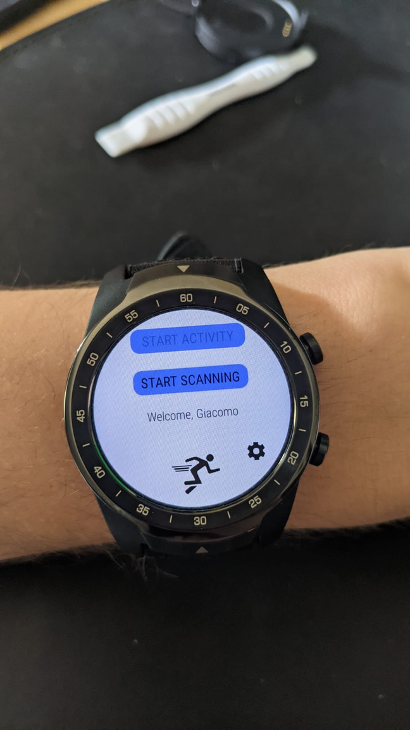
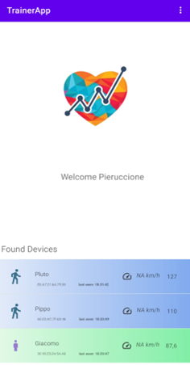

BLE connection strategy
Client side
Server side
1
start GATT server & BLE advertising
advertise a chosen service UUID
start BLE scanning
2
Exposed GATT services:
AthleteInformationService
AthleteNameCharacteristic
HeartRateService
AthleteHeartRateCharacteristic
MovementService
AthleteActivityCharacteristic
AthleteSpeedCharacteristic
AthletePeaceCharacteristic
AthleteStepCounterCharacteristic
AthleteDistanceCharacteristic
filtering results by advertised service UUID
server found?
NO
YES
notify the user
show restart scanning button
3
connect to GATT server
if some of the required services are missing, force service discovery
this happens because of a wrong caching mechanism in Android BLE GATT library

Slide 25
DATA FLOW
1
a new value is received from the sensor
the reads are filtered by criteria of context awareness
an Intent is fired to the GATTClientService
2
with the type of data and the value read
CLIENT SIDE
3
The message is queued for write to server
The characteristic to write to is selected by the data kind
The GATTServer receives Write request
4
depending on the characteristic data is converted and stored
SERVER SIDE
5
AthleteManager class fires an Intent
with the updated Athlete object
The activity receives the update
6
the athleteAdapter is notified to update the view

Slide 26
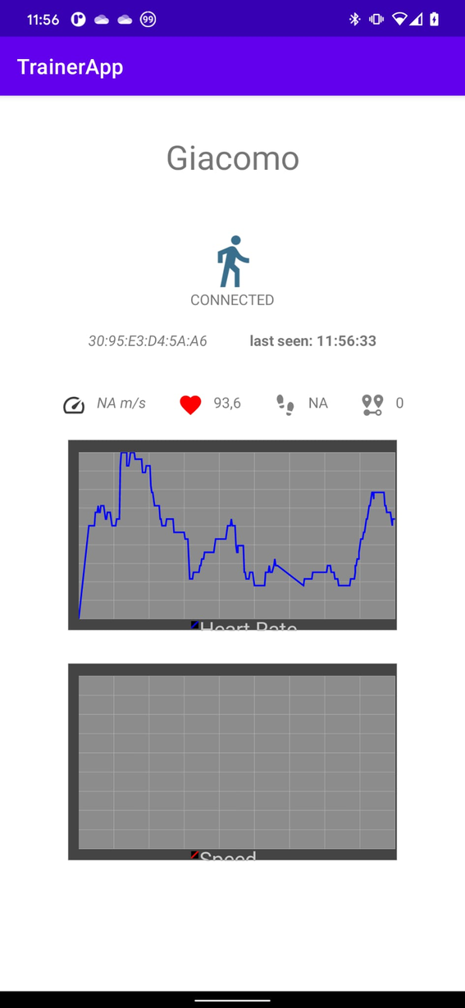
TRAINER-SIDE
USER INTERFACE
MainActivity
Shows a list of the athletes that joined the training session
AthleteDetailsActivity
All the historical and current statistic for the selected athlete are shown
SettingsActivity
Where the trainer can set its name

Slide 27
Observations
1
WearOS is a constrained version of android also in dev terms
2
Android BLE GATT library is not a pleasure
The libraries and hardware access API available are limited, not all the standard android features are granted.
Developing over Android BLE GATT protocol standard library needs lots of testing phase to discover every network scenario, and every thing has to be managed manually.

Slide 28
Possible future improvements
1
Data processing
2
Network topology
Improving the sensed data selection phase
Storing the past training data in a persistent way
Elaborating training summary data for each athlete
classifying the training quality of the athlete not by static ranges, but considering its past training data and its physical statistics
In order to overcome the BLE hardware limit on the number of connected devices, it could be a solution to implement a mesh topology for the bluetooth network, in which every athlete can route the messages to the trainer

Slide 29
Thank you

